Slide 1
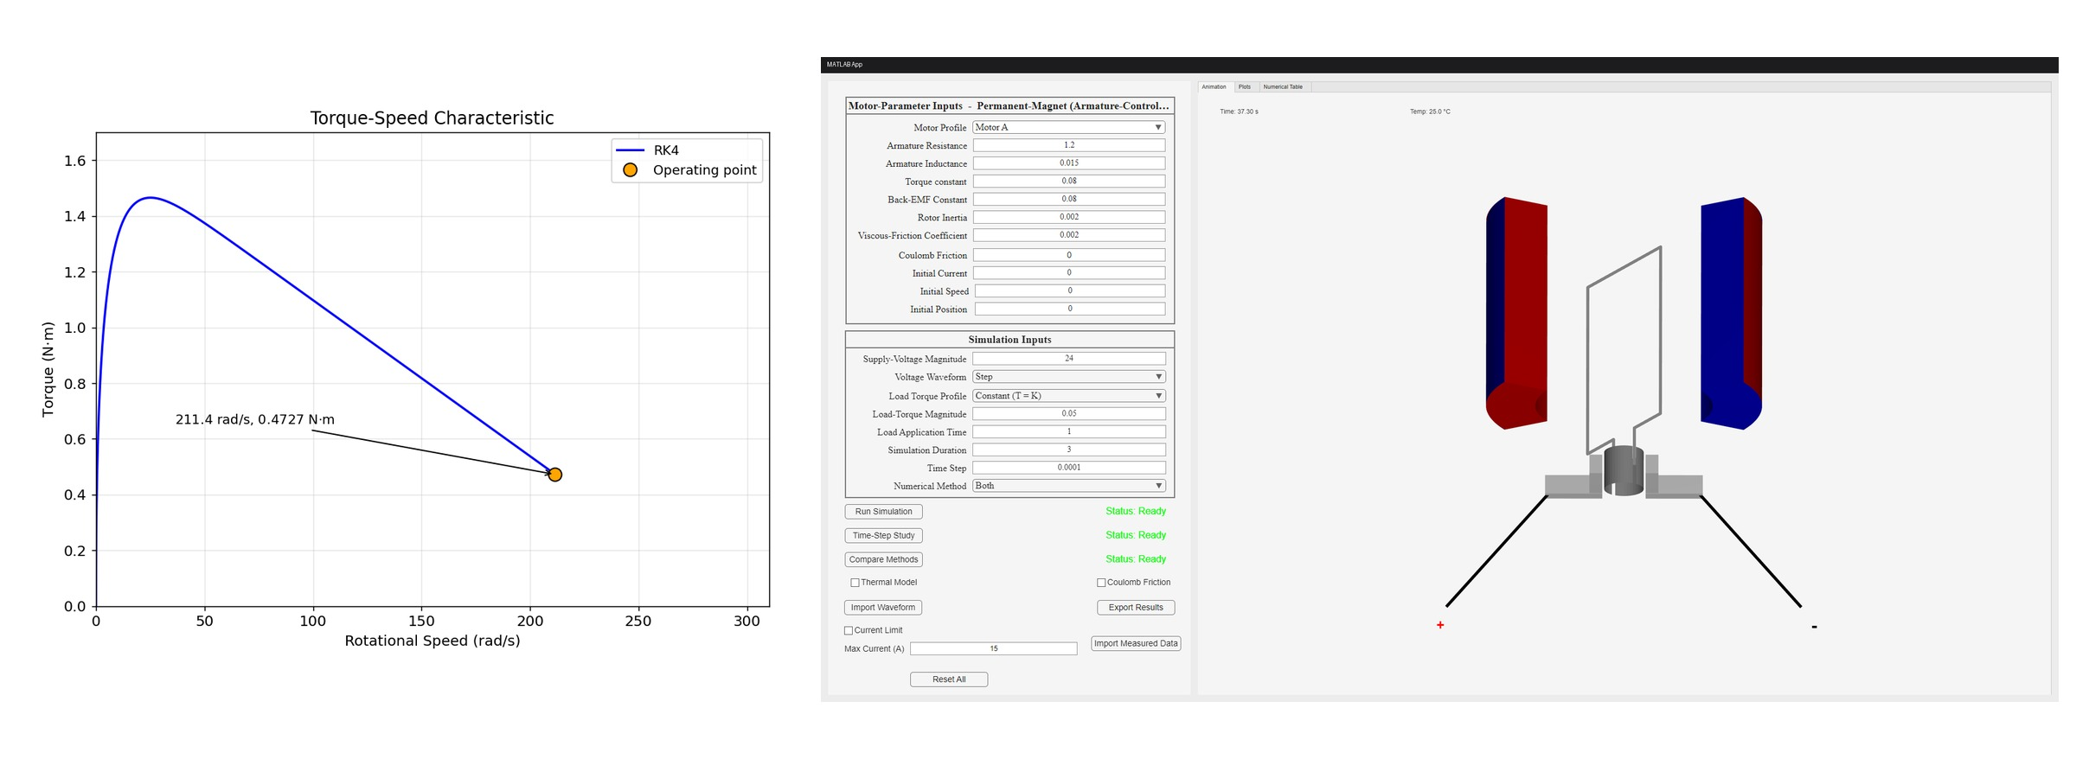
DC Motor Dynamic Simulator
Submitted by - Group 04
Shuvro Pain
2406177
Taseen Intisar
2406188
Abdus Samiul Hasan Sun
2406193
Nadman Wasit
2406195

Slide 2
Outline
Summary
Introduction
Design
Implementation
Analysis and Evaluation
Future Work
References

Slide 3
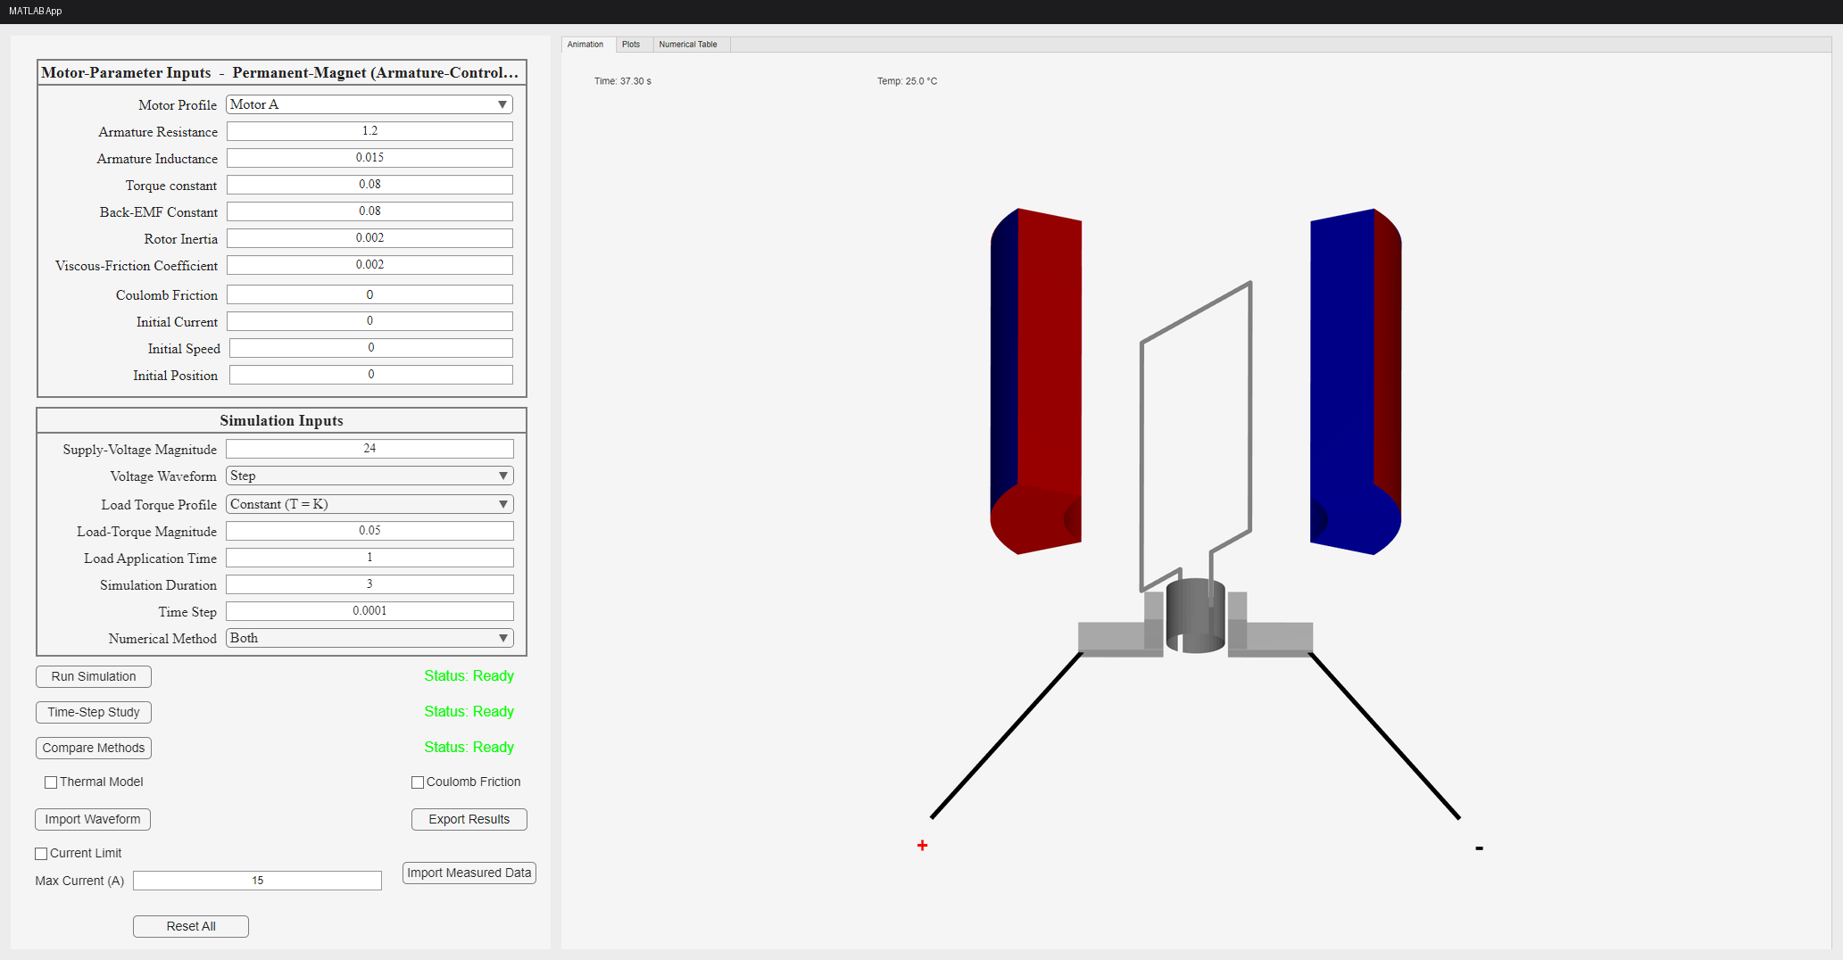
1. Summary / Abstract
MATLAB App Designer application that simulates an armature-controlled DC motor
  Models the coupled electrical and mechanical dynamics of the machine
Three core states solved numerically: armature current, speed, shaft position
Forward Euler and RK4 implemented from first principles
  ode45 used only as a validation reference, never as the solver
Interactive GUI with animation, plot views and a numerical results table
Optional extensions: thermal model, current limiting, Coulomb friction, speed-dependent loads

Slide 4
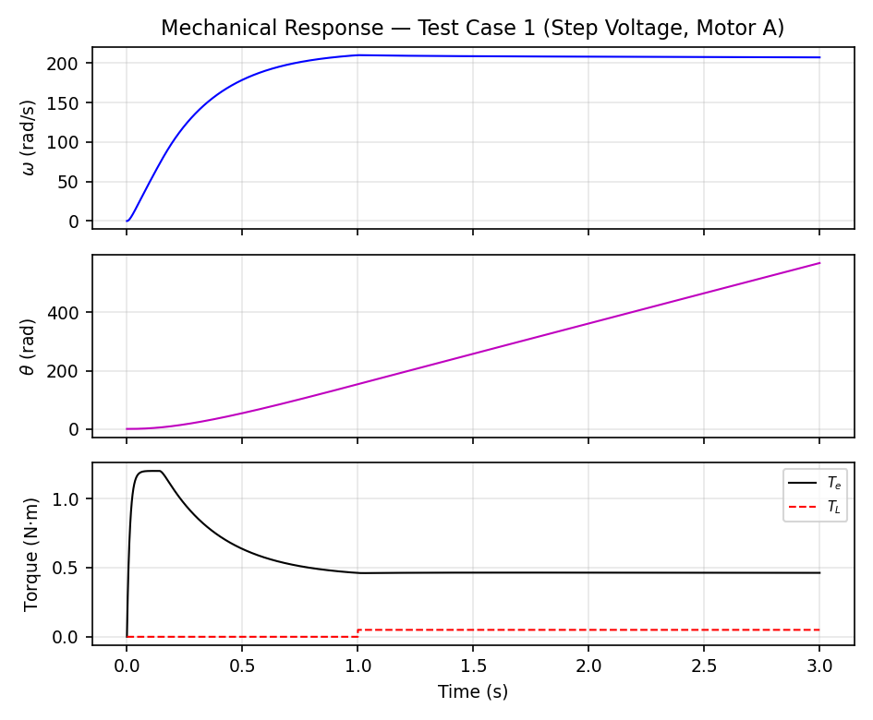
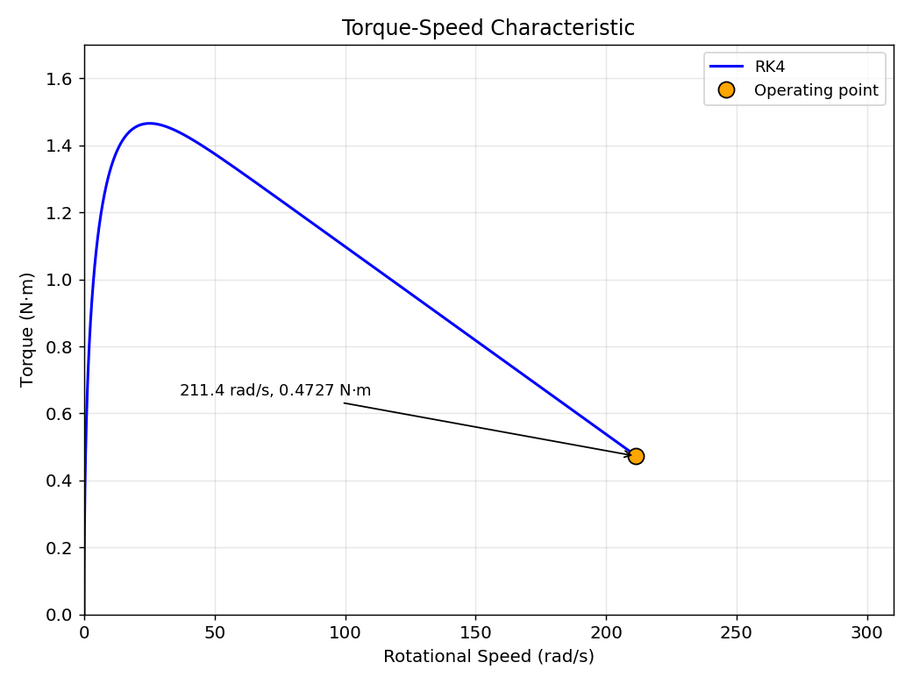
2. Introduction
A DC motor converts electrical energy into mechanical energy
Current, speed and position all vary with time - it is a dynamic system
Electrical and mechanical subsystems are coupled through back-EMF and torque
  No closed-form solution once current limiting or a speed-dependent load is added
Numerical integration is required to predict the transient response

Slide 5
3.1 Design: Problem Formulation (PO(b))
3.1.1 Identification of Scope
Problem
  Formulate the coupled differential equations of an armature-controlled DC motor
  Solve them numerically and analyse the dynamic response
  Compare at least two numerical integration methods
Scope
  States: armature current, angular speed, shaft position
  Variable applied-voltage waveforms and load-torque characteristics
  Forward Euler and RK4 implemented; ode45 for validation only
  Optional: thermal model, current limit, Coulomb friction, adaptive RK45, animation
  Out of scope: magnetic saturation, regenerative braking into the supply

Slide 6
3.1 Design: Problem Formulation (PO(b))
3.1.2 Literature Review
Chapman, Electric Machinery Fundamentals - DC motor operating principles
Chapra & Canale, Numerical Methods for Engineers - Euler and Runge-Kutta methods
MathWorks ODE documentation – ode45 for adaptive time-step integration
MathWorks App Designer documentation - GUI components, callbacks, axes and tables

Slide 7
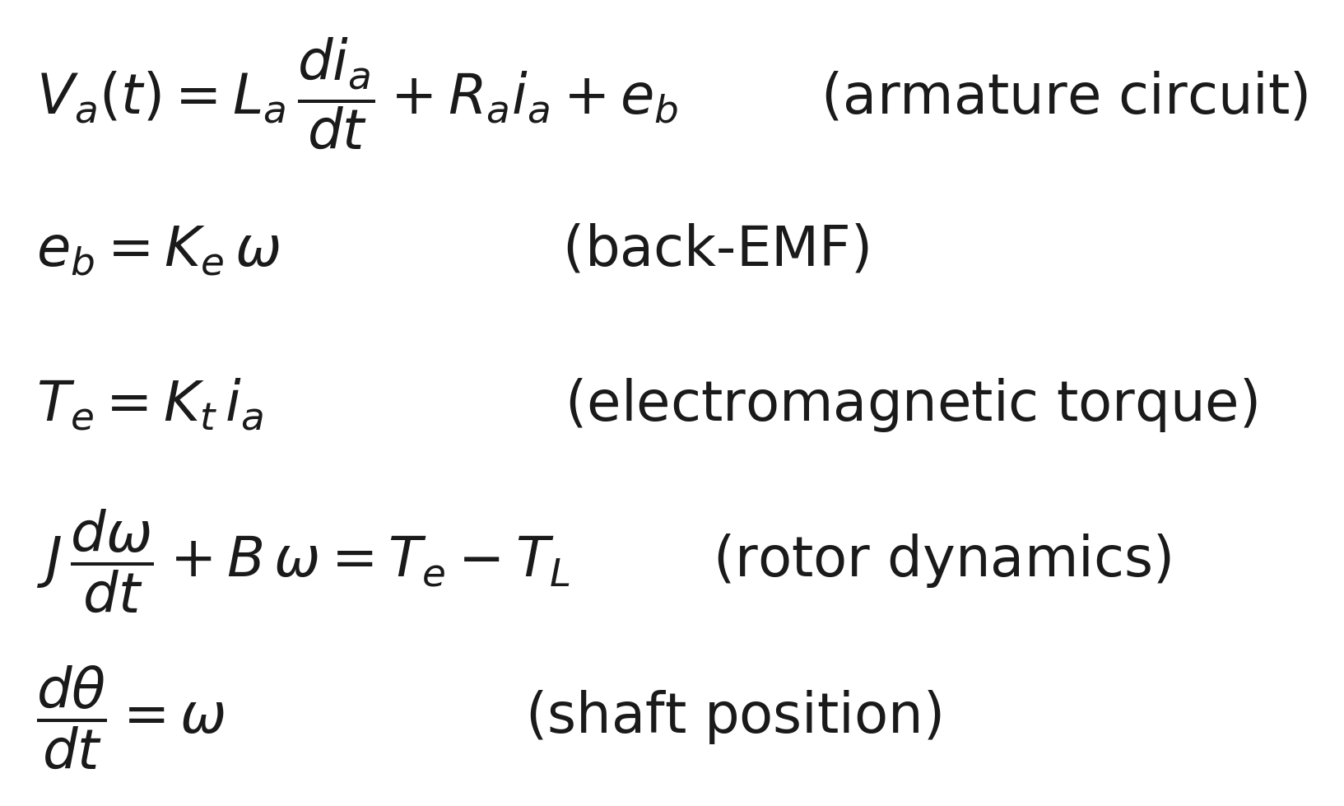
3.1 Design: Problem Formulation (PO(b))
3.1.3 Formulation of Problem
Kirchhoff voltage law on the armature circuit, Newton second law on the rotor
Coupled through the back-EMF constant Ke and the torque constant Kt

Slide 8
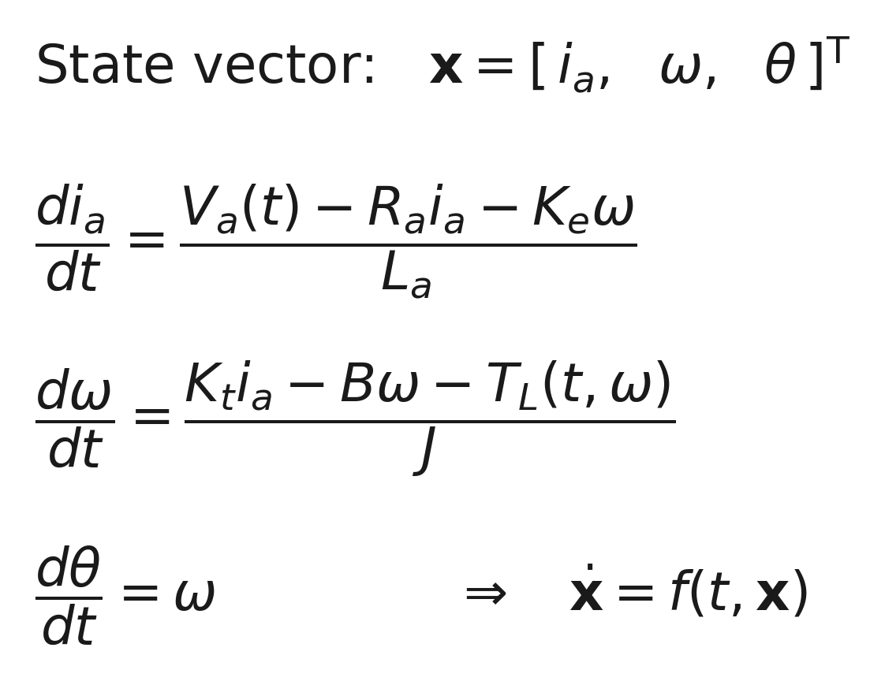
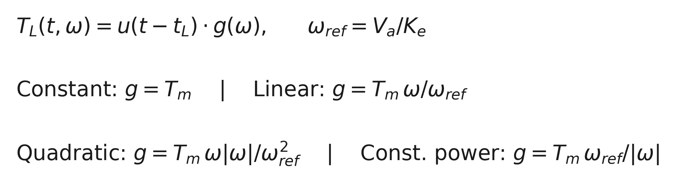
3.1 Design: Problem Formulation (PO(b))
3.1.4 Analysis
Rearranged into explicit state-derivative form for the numerical solvers
Load torque follows a torque-speed characteristic

Slide 9
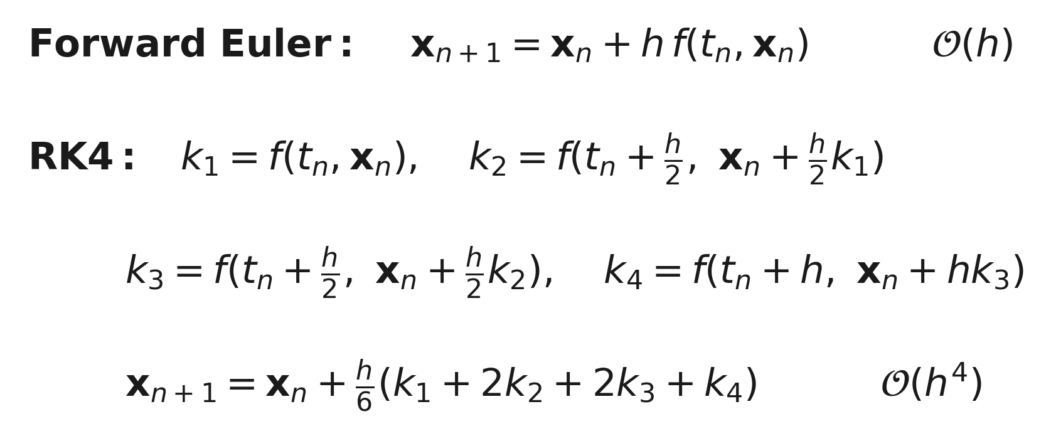
3.2 Design: Numerical Methods
Two explicit fixed-step integrators written directly, not called from a toolbox
Both advance the same shared state-derivative function, so the model is identical
Euler: 1 derivative evaluation per step | RK4: 4 evaluations per step, ~30-50x larger h for the same accuracy
Final RK4 stage evaluates its inputs at the left limit of the interval so step inputs do not break 4th-order accuracy

Slide 10
3.3 Design: Simulation Model and GUI
Left panel: motor parameters and simulation inputs
Voltage: step, ramp, pulse, imported CSV, user-defined
Load: constant, linear, quadratic, constant-power, imported
Tabs: Animation, Plots, Numerical Table
  Plot View selects Torque-Speed, Electrical, Mechanical or Numerical Analysis
Controls: Run Simulation, Compare Methods, Time-Step Study, Import, Export, Reset
Toggles: thermal model, Coulomb friction, current limit

Slide 11
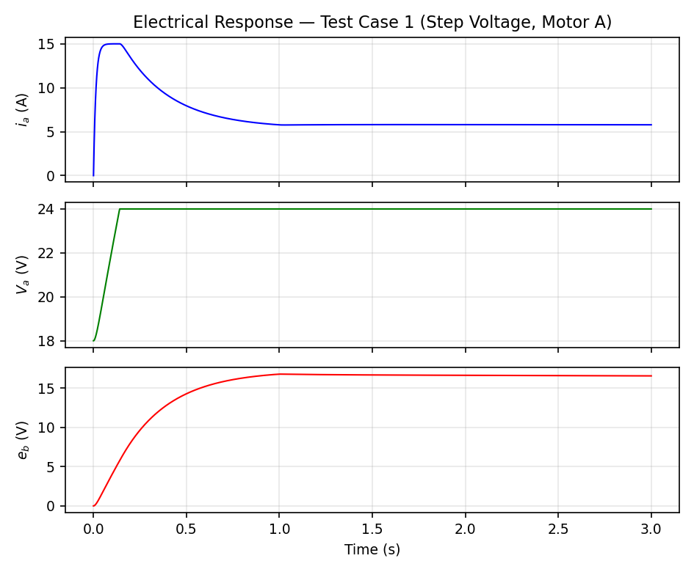
4. Implementation: Test Case 1 - Electrical Response (Current-Limited)
Motor A, 24 V step at t = 0, 0.05 N.m load at t = 1 s, 3 s run, h = 1e-4 s - current limiter ON (15 A)
15 A limiter clamps the current for ~150 ms; voltage rises 18 V to 24 V as back-EMF builds. (Limiter off: baseline peak is 18.32 A.)

Slide 12
4.1 Implementation: Test Case 1 - Mechanical Response (Current-Limited)
Speed, shaft position and the torque balance for the same run
Speed settles at 211.4 rad/s - same as with the limiter off, since it only reshapes the transient. Torque absorbs the load step at t = 1 s.

Slide 13
4.2 Implementation: Torque-Speed Characteristic (Baseline, No Limiter)
Blue curve: the simulated transient trajectory, from standstill to steady state
Marker: the operating point - where the run settles
211.4 rad/s, 0.4727 N·m at that point
Equals Bω + T_L at that speed - the torque balance at steady state
  Verified against the analytical steady state to within 0.01 rad/s

Slide 14
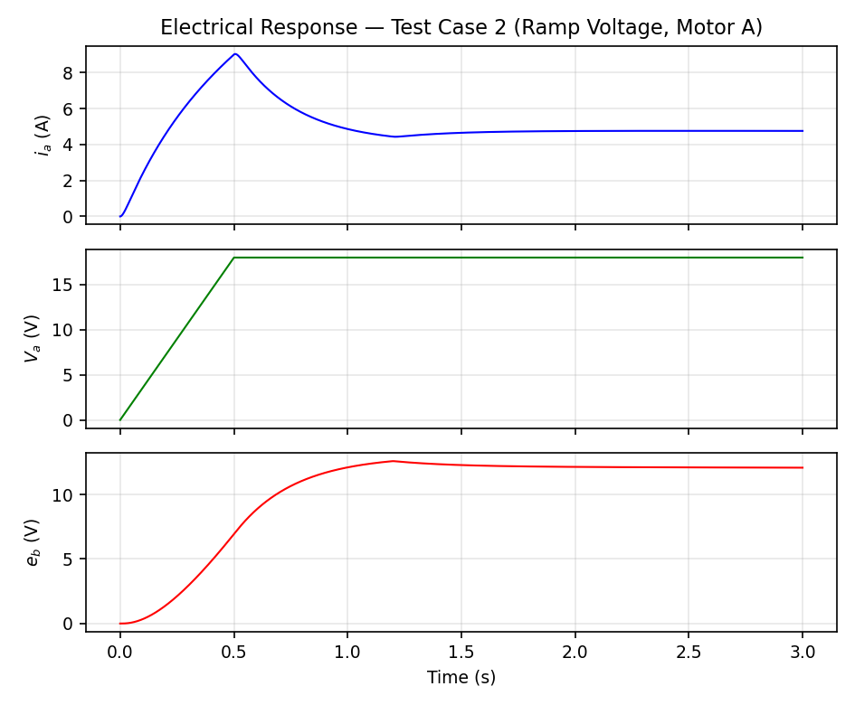
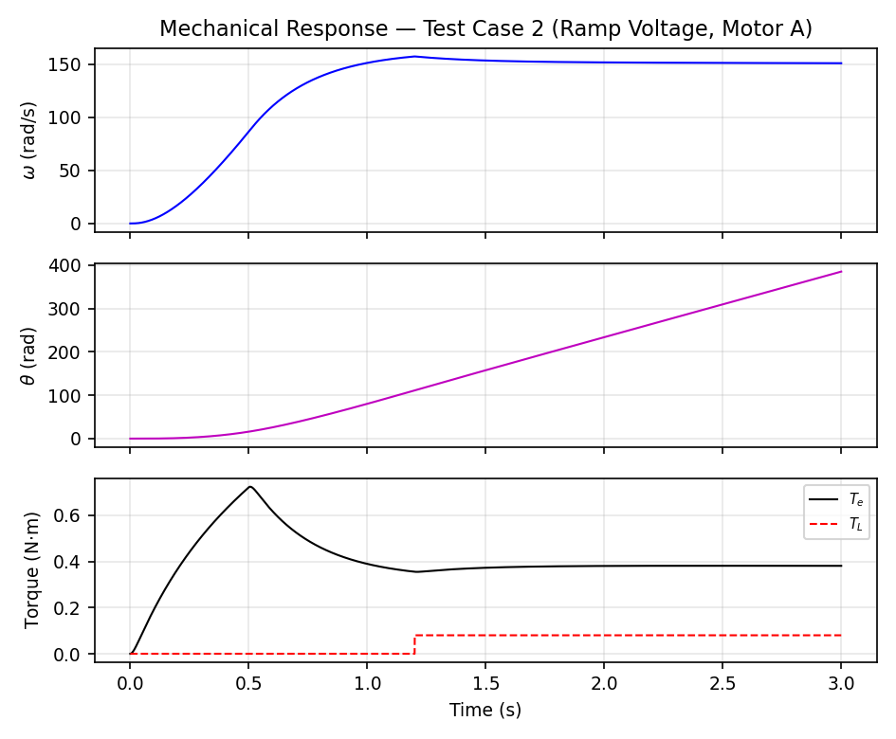
4.3 Implementation: Test Case 2 - Ramp Voltage
Motor A, 18 V ramped over 0.5 s, 0.08 N.m load at t = 1.2 s, 3 s run, h = 2e-4 s
Electrical response
Gradual voltage rise limits the peak current to 9.05 A, so the 15 A limiter never engages
Mechanical response
Speed settles at 151.0 rad/s; the 0.08 N.m load is applied at t = 1.2 s
Pulse and imported-waveform cases (Test Cases 3 and 4) are in the full report, Section 4.3.

Slide 15
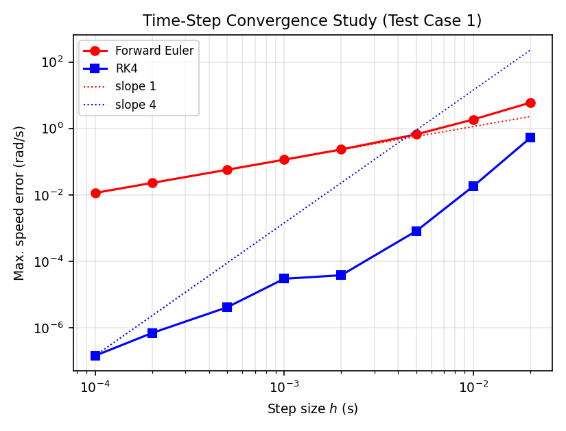
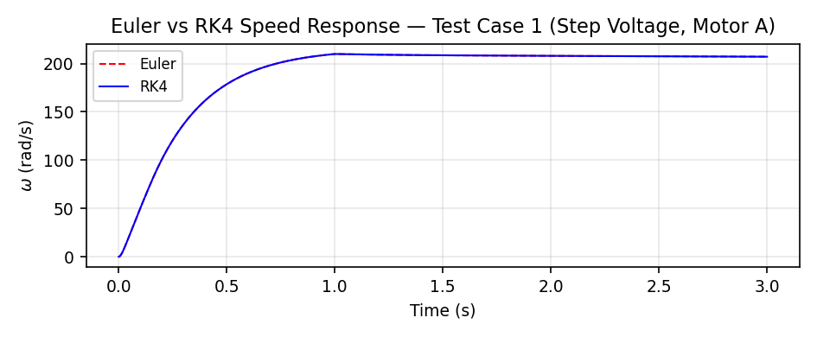
4.4 Numerical Analysis: Method Comparison and Time-Step Study
Errors measured against a fine-step RK4 reference (h = 1e-5 s)
Euler error follows the expected first-order trend
RK4 shows the expected fourth-order convergence overall
At h = 1e-3 s: Euler 0.114 rad/s vs RK4 3.0e-5 rad/s
Deviations from ideal 16x scaling occur from reference-error limits and input discontinuities
Unstable step sizes are detected and excluded, not plotted

Slide 16
5. Design Analysis and Evaluation
5.1 Investigations (PO(d))
5.2 Limitations of Tools (PO(e))

Slide 17
5.1 Investigations (PO(d))
Design of experiment
  Euler and RK4 run at eight step sizes from 1e-4 to 2e-2 s
  Maximum speed error measured against a fine-step RK4 reference
Results
  Euler: approximately first-order convergence
  RK4: fourth-order convergence as an overall trend
  Individual step-to-step error ratios deviate from the ideal 16x scaling
  Both methods stable across the tested range
Finding during development
  RK4 silently dropped to first order on steps meeting an input discontinuity
  Corrected by evaluating the final stage at the left limit of the interval

Slide 18
5.2 Limitations of Tools (PO(e))
Fixed-step solvers need the user to choose h
  Motor A electrical time constant is ~13 ms
  Euler diverges above h ~ 26 ms, RK4 above h ~ 36 ms
  The Time-Step Study detects divergence and reports it instead of plotting it
ode45 reference is itself limited by its tolerances (set to 1e-10 here) and by rounding
Current limiter is an idealised instantaneous voltage clamp, not a real chopper or PWM stage
Thermal model is lumped first-order - no spatial temperature gradient in the windings
Animation speed depends on the host machine redraw rate

Slide 19
6. Future Work
Regenerative operating mode - returning energy to the supply when overhauled by the load
Magnetic saturation of the torque and back-EMF constants at high current
Full closed-loop PWM current-limiting model in place of the idealised voltage clamp
Closed-loop speed and position control (PI / PID) built on the present plant model
Export the animation as a video file alongside the existing CSV data export

Slide 20
7. References
S. C. Chapra and R. P. Canale, Numerical Methods for Engineers, McGraw-Hill.
S. J. Chapman, Electric Machinery Fundamentals, McGraw-Hill.
MathWorks, MATLAB Ordinary Differential Equation Documentation.
MathWorks, MATLAB App Designer Documentation.
EEE 212 Numerical Techniques Laboratory, MATLAB Project Handbook, Dept. of EEE, BUET.

